Slide 1
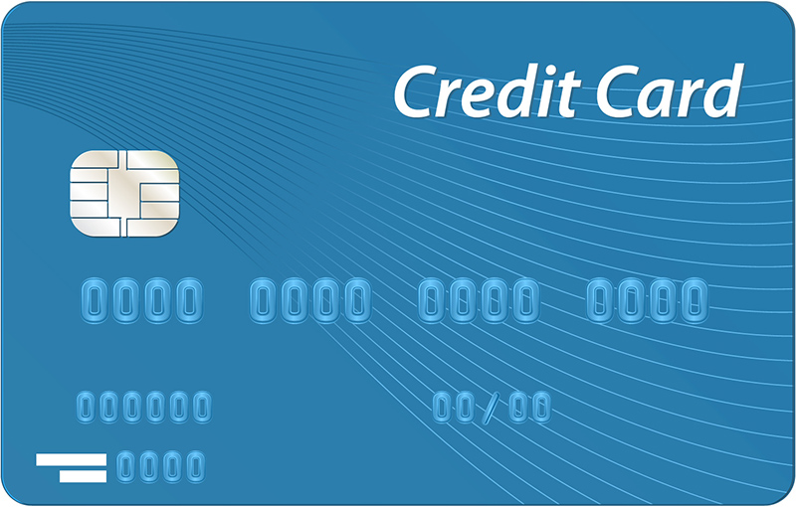
Default on Credit Card Payment
Usha

Slide 2
Default on Credit Card Payment
The purpose of this project is to develop a predictive model that can be used to help the organizations use their data to make better decisions. This is achieved by applying classification techniques to organizations’ data source to make the predictions.
A predictive analytics application allows the organization to identify the risks and address them in real time to reach better outcomes. For example, when a customer asks to apply for a new credit card or increase their monthly credit balance, it is necessary for the bank to analyze available data related to that customer before making the decision.

Slide 3
Agenda
Data Collection
Data Wrangling
Exploratory Data Analysis
Transforming
Modeling
Evaluation

Slide 4
Data Collection
The Dataset used is Default of Credit Card Clients. The dataset contains information on default payments, demographic factors, credit data, history of payments, and bill statements of credit card clients in Taiwan from April 2005 to September 2005.
The original dataset can be found here at the UCI Machine Learning Repository

Slide 5
Data Description
Explanatory Variables
limit_bal : Amount of the given credit (NT dollar)
sex : Gender (1 = male; 2 = female)
education : Education (1 = graduate school; 2 = university; 3 = high school; 4 = others)
marriage : Marital status (1 = married; 2 = single; 3 = others)
age : Age (years)
pay_1 - pay_6 : History of past payment from Apr2005 - Sept2005
bill_amt1-bill_amt5 : Amount of bill statement(NT dollar) from Apr2005 - Sept 2005
pay_amt1-pay_amt6 : Amount of previous payment(NT dollar) from Apr2005 - Sept 2005
Response Variables
default payment next month : Default payment(1 = yes ; 0 = no)

Slide 6
Data Wrangling
Clean up
All the column names are in uppercase hence we explicitly changed to lowercase.
Rename the column names when required, In particular, remarkably this dataset misses a column PAY_1.
In the analysis here below we assume that PAY_0 is actually pay_1, to be consider the repayment of the month prior to the month where we calculate the defaulting (which is October 2005, in this particular dataset).
Since Column id is not adding much value to the dataset we dropped.

Slide 7
Nominal Variables
According to Data Dictionary the attribute education has broadly divided into four categories i.e Graduate School, University, High School and Others. But when look into data we have 7 categories. For this analysis we have removed extra categories which not mentioned in Data Dictionary are dropped.
Marriage has to be 3 categories but actually have 4 (4= na).
Convert default payment next month as 'target', sex, marriage, education, age and the pay_* columns into categories. Create another column as 'age_cat' with 6 bins as [20,30] [30,40][40,50] [50,60] [60,70] [70,80].

Slide 8
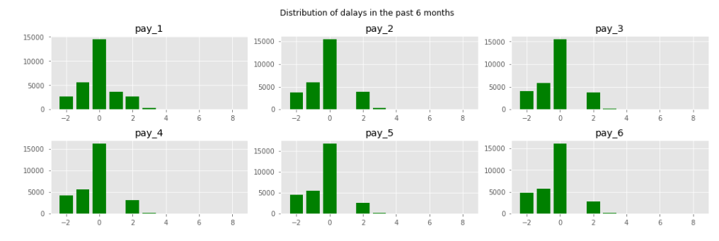
Exploratory Data Analysis
payment delays
The measurement scale for the repayment status is either negative or 0 means upfront or on par. If repayment status is positive means running behind payments. If positive repayment status is very high indicates risk of future defaulter.

Slide 9
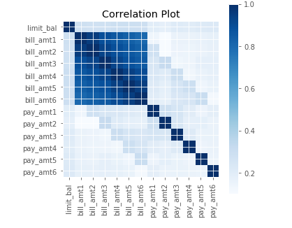
Higher Dimensionality Visualizations
The plot shows a strong correlation between credit limit and billing amounts from BILL_AMT6(April 2005) to BILL_AMT1 ( Sep. 2005) and no correlation between credit limit and payment status during that period.

Slide 10
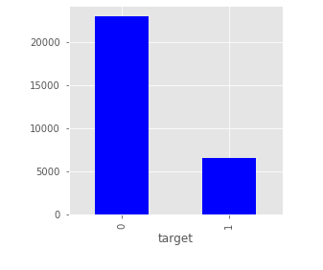
Dive deep into defaulting
How many observations do we have in our dataset?
Total observations are 29655.(1 = Default , 0 = Not Default)

Slide 11
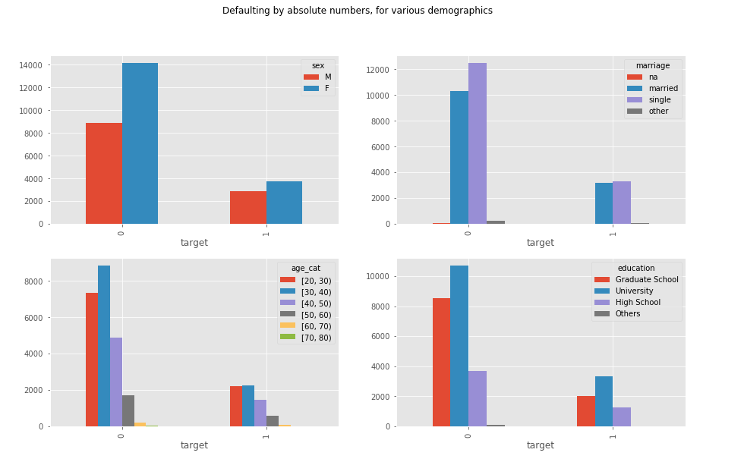
Absolute Statistics for Various Demographics
Default rate is high in Female, single, age category [30,40] and University.

Slide 12
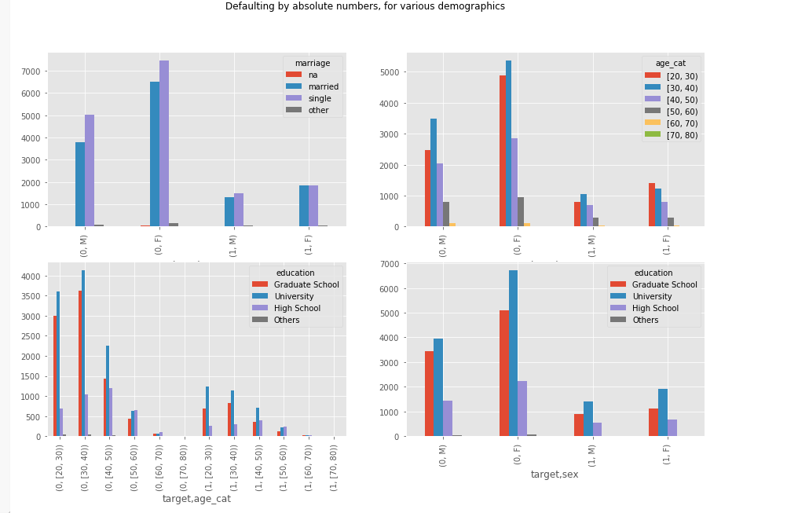
Default rate is high in female married/single, age[20,30],University.

Slide 13
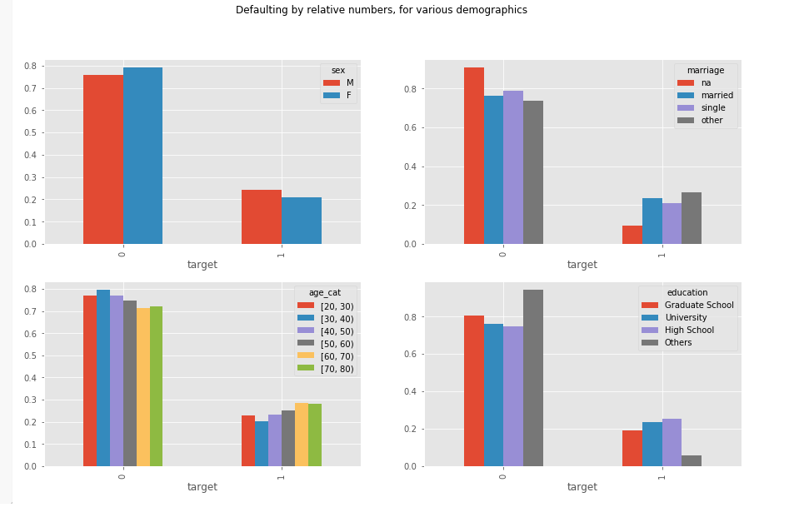
Statistics relative to the population
Now statistics are different. Default rate is high in male , marriage –other, age[60,70],education -High School.

Slide 14
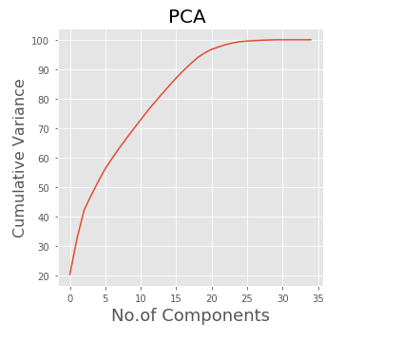
Transforming
Feature selection is a process in which automatically features are selected which contributes most to the prediction variable. The question next comes into our mind is how many components? Initially start with any no. of components of your choice and fit a model. Next plot no.of components Vs cumulative variance to get a clear picture.
We have taken 29 components into account and transformed the data.

Slide 15
Modeling
Divide the data into train and test by 70 / 30.
Since its Classification problem we are building following Models.
Logistic Regression
SVC Linear
SVC rbf
Random Forest
K-NN

Slide 16
Machine Learning Algorithm Process
Input: A training set of N data points
Learning: Use the training set to learn what every one of the classes looks like.
Evaluation: Predict labels for a test set of data and compare the true labels(ground truth ) to the ones predicted by the classifier.

Slide 17
Evaluation
classification Report
Model | Recall (0.0 = Not Default) | Recall (0.1 = Default) | Accuracy
Logistic Regression | 0.96 | 0.27 | 0.806
SVC -Linear | 0.96 | 0.25 | 0.803
SVC - rbf | 0.96 | 0.32 | 0.811
Random Forest | 0.94 | 0.34 | 0.807
K-NN | 0.95 | 0.28 | 0.801

Slide 18
Analysis and Recommendation
In order to identify the customers that would fail to pay the credit card amount duly, the prediction model should not make any wrong predictions on those who are classified into class “no default payment” (0) but actually are in class “default payment” (1). Therefore, the lower number of false negatives would be preferred.
In this case, recall would be of higher importance as it reflects the percentage of positive tuples that classifier labeled as negative. Higher recall means the classification model is more likely to identify more clients that have high chance of having a default payment, which could potentially lead to the loss for the bank. In term of finance, the classification model would help the bank prevent loan loss, improve the performance and maximize the efficiency.

Slide 19
Cont.
The analysis of different classifying algorithms does help future research in this field. All algorithms have produced an accuracy of about 80%. We can choose Random Forest to be the best as it has the highest recall value for this data set.

Slide 20
Thank You

